Slide 1
Time Series Analysis: Road Casualties in Great Britain 1969-1984
By: Steven Cocke
August 17, 2019

Slide 2
Agenda
Audience Assumptions
Context/Problem Statement/Scenario
Dataset Explanation
Model Fitting – AR/ARMA/ARIMA/Ensemble
Model Fitting – VAR
Model Fitting – Neural Network
ASE Comparison
Model Selection and Forecast

Slide 3
Audience Assumptions
Familiar with Time Series Analysis and basic concepts
ACF
MSE
AIC/BIC
Seasonality
Univariate and Multivariate regression
Neural Networks
Basic understanding of R

Slide 4
Context
The year is 1984 and the Prime Minister has asked me to look at driver deaths for data from 1969-1984 and perform analysis.
New laws have come into place in the recent past and want to see if any difference has been made
Wants to see if I can successfully model the time series as well as predict drive deaths for the next 15 months into the future (1985-1999)

Slide 5
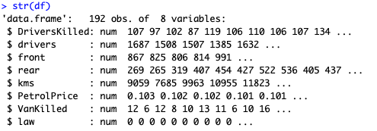
Dataset Explanation
Dataset Road Casualties in Great Britain 1969-1984
Also called “Seatbelt” dataset from datasets package in R

Slide 6
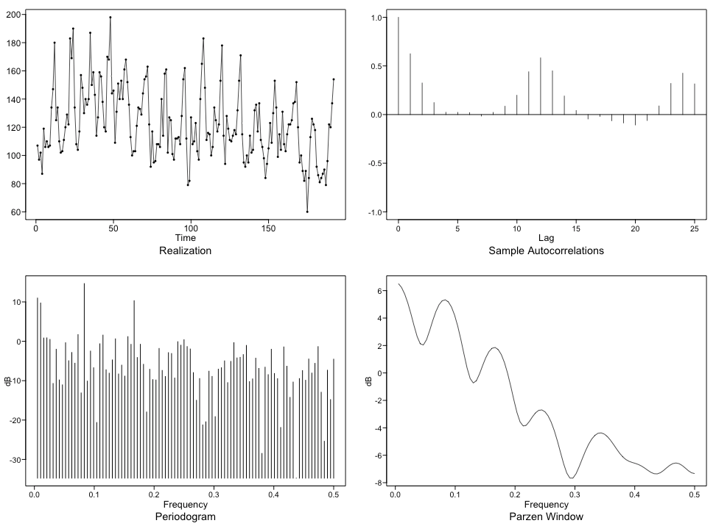
Model Fitting – AR/ARMA/ARIMA/Ensemble
Plotting DriversKilled Attribute

Slide 7
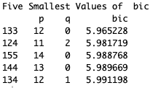
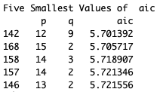
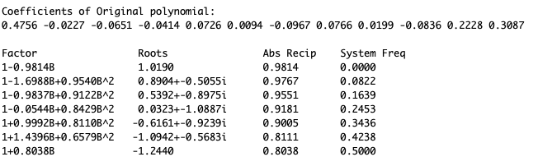
Model Fitting – AR/ARMA/ARIMA/Ensemble
Phi Estimation and AIC/BIC

Slide 8
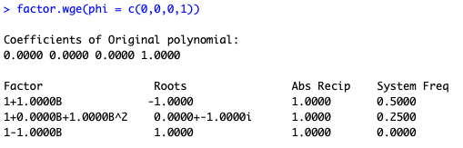
Model Fitting – AR/ARMA/ARIMA/Ensemble
Factor Tables Comparison for Seasonality

Slide 9
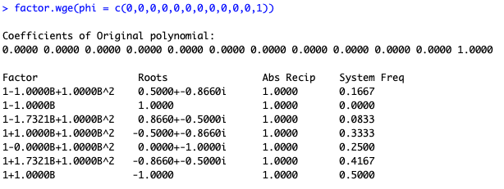
Model Fitting – AR/ARMA/ARIMA/Ensemble
Factor Tables Comparison for Seasonality

Slide 10
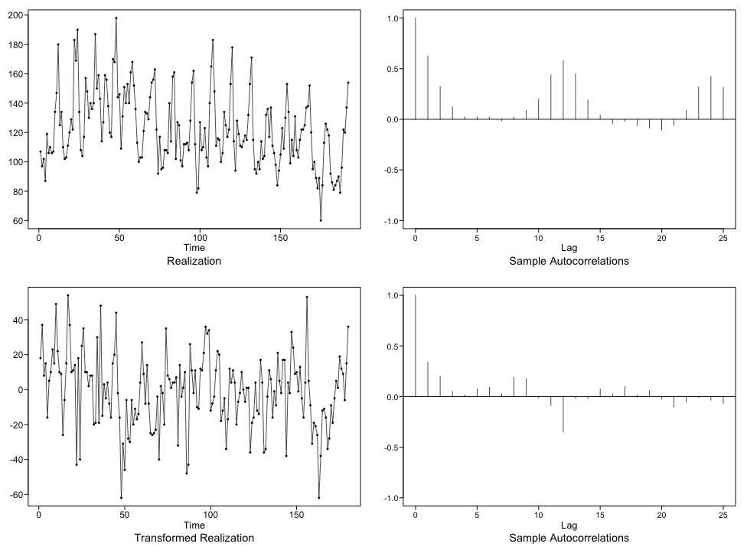
Model Fitting – AR/ARMA/ARIMA/Ensemble
Transformation for s=12

Slide 11
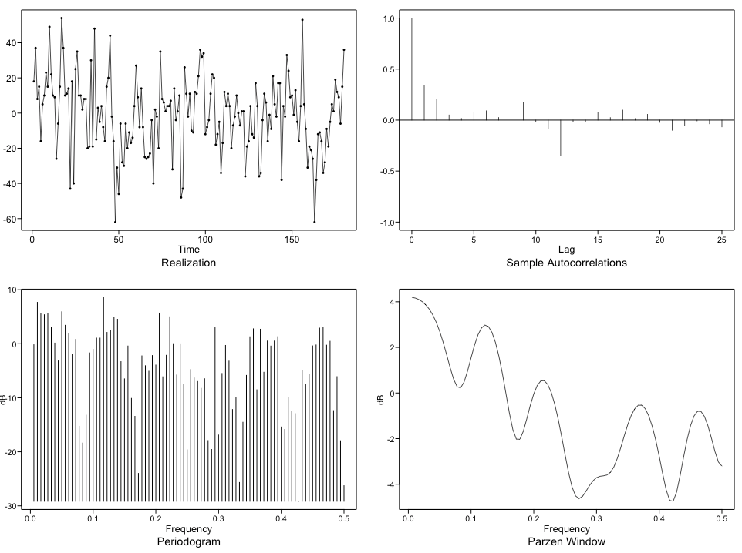
Model Fitting – AR/ARMA/ARIMA/Ensemble
Transformation for s=12

Slide 12
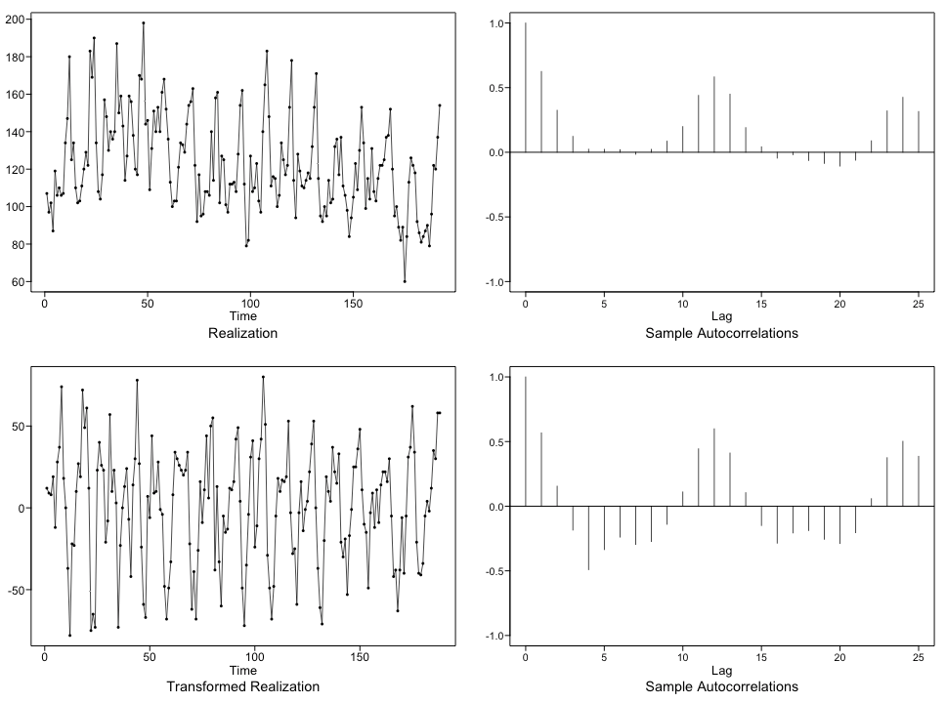
Model Fitting – AR/ARMA/ARIMA/Ensemble
Transformation for s=4

Slide 13
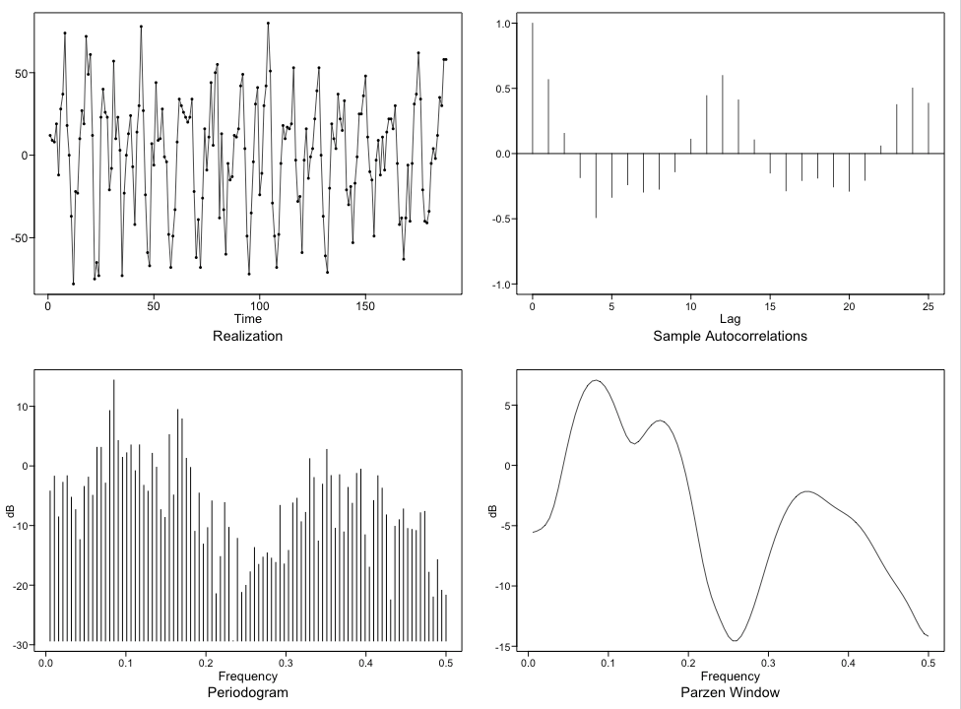
Model Fitting – AR/ARMA/ARIMA/Ensemble
Transformation for s=4

Slide 14
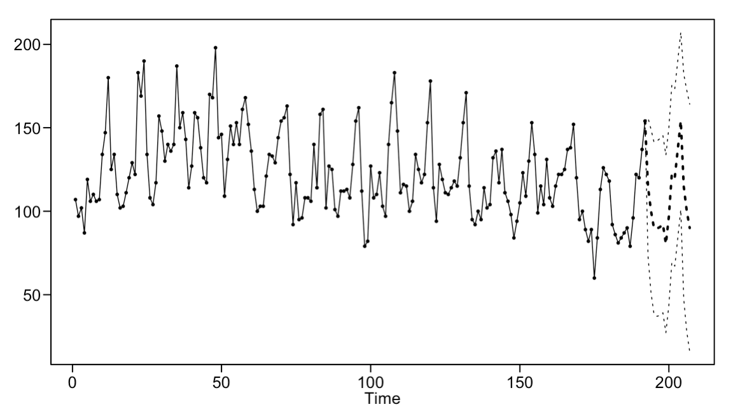
Model Fitting – AR/ARMA/ARIMA/Ensemble
With seasonal component s=12

Slide 15
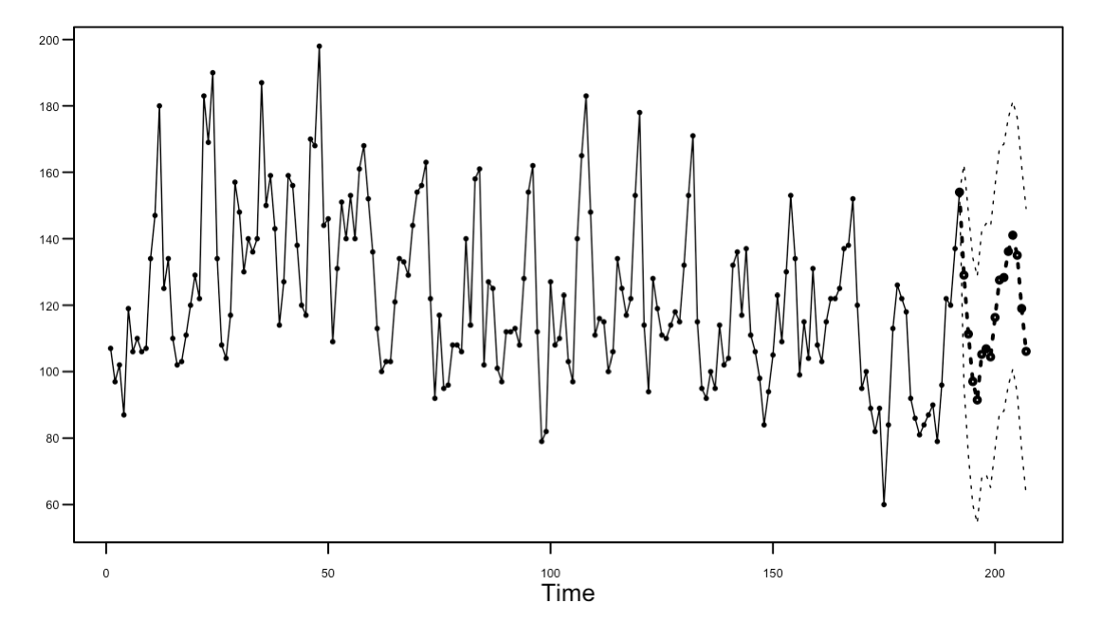
Model Fitting – AR/ARMA/ARIMA/Ensemble
Without seasonal component

Slide 16
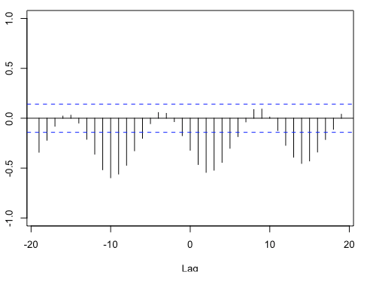
Model Fitting – VAR
CCF Plot
Kms Driven vs DriverDeaths

Slide 17
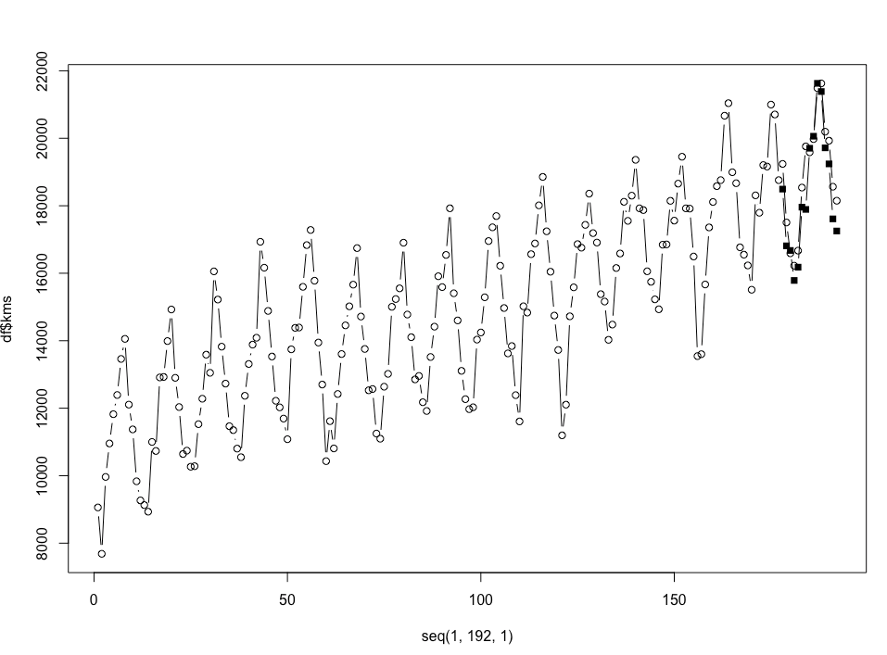
Model Fitting – VAR
Multivariate Analysis kms

Slide 18
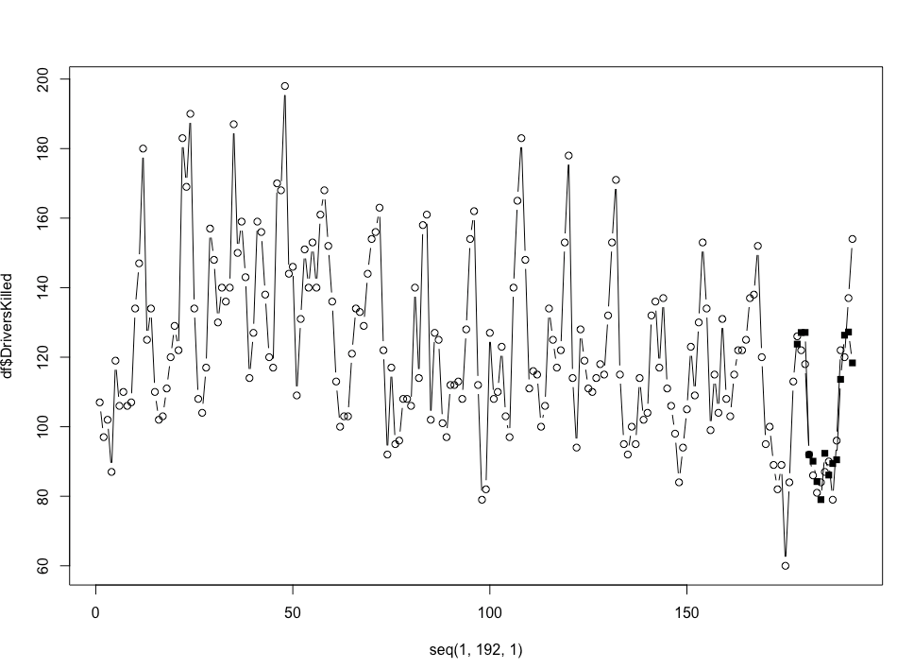
Model Fitting – VAR
Multivariate Analysis driver deaths

Slide 19
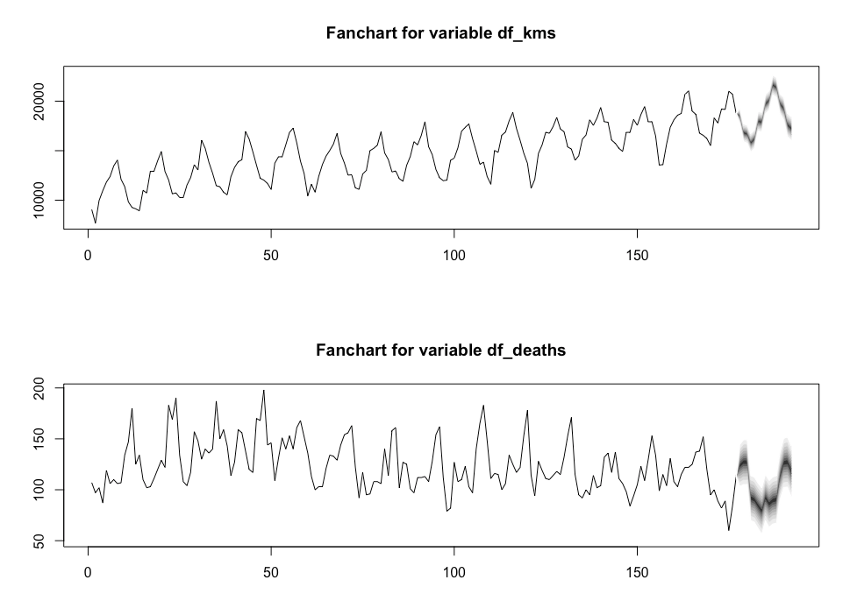
Model Fitting – VAR
Multivariate Analysis

Slide 20
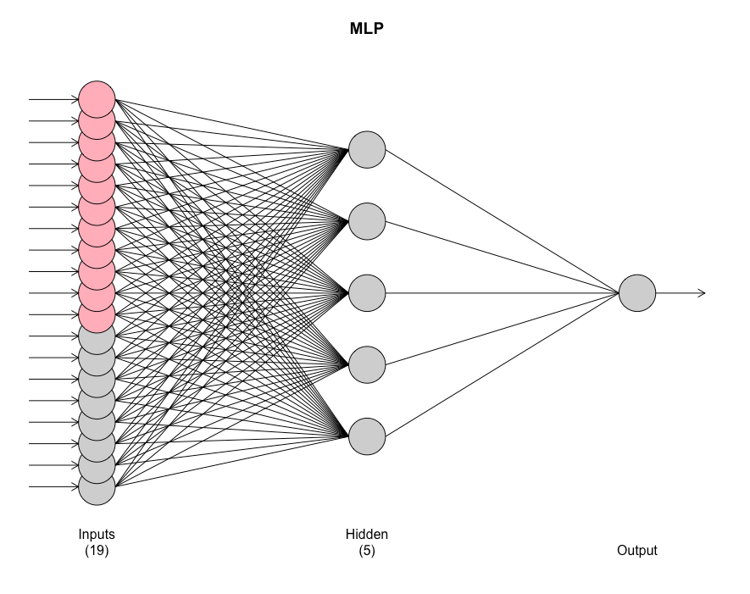
Model Fitting – Neural Network
Time as only Regressor

Slide 21
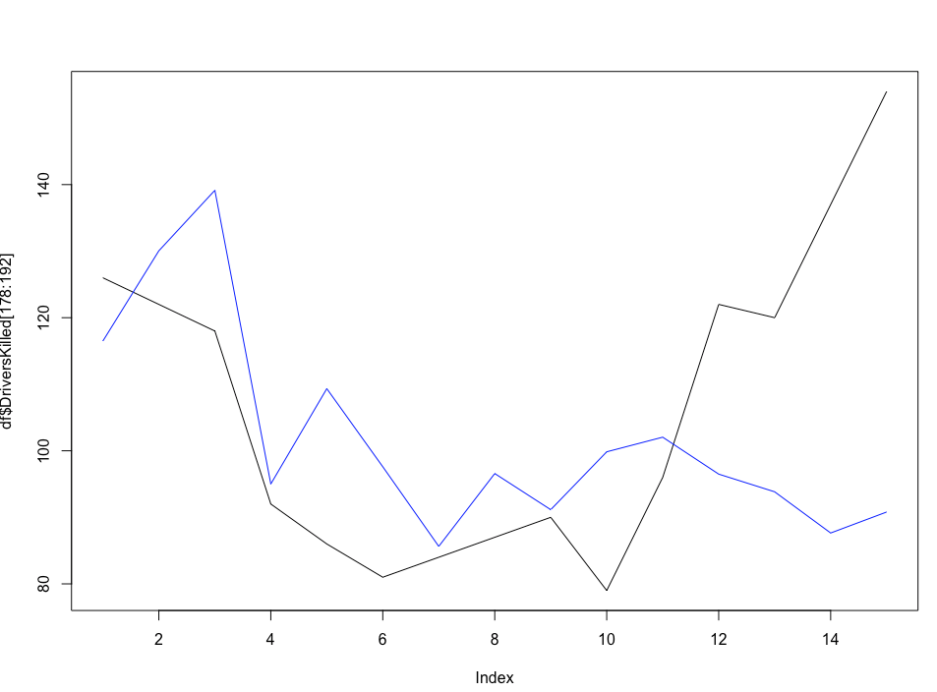
Model Fitting – Neural Network
Time as only Regressor

Slide 22
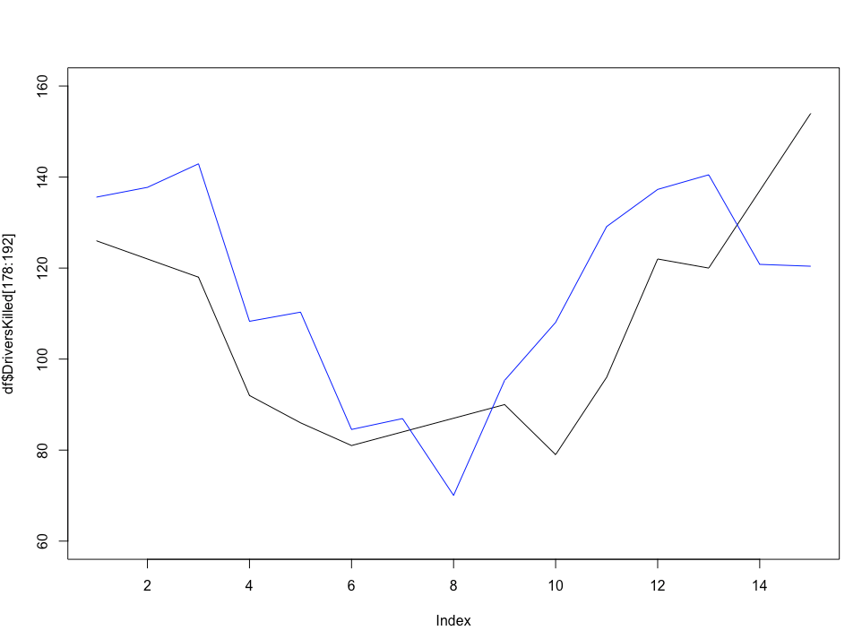
Model Fitting – Neural Network
Additional Regressors (Pretrol Price and Drivers)

Slide 23
ASE Comparison
Model | ASE
ARIMA(1,12,0) | 196.66
ARIMA(1,4,0) | 941.45
ARMA(12,5) | 112.93
VAR | 121.65
NN - UniRegressor | 650.93
NN - MultiRegressors | 409.41

Slide 24
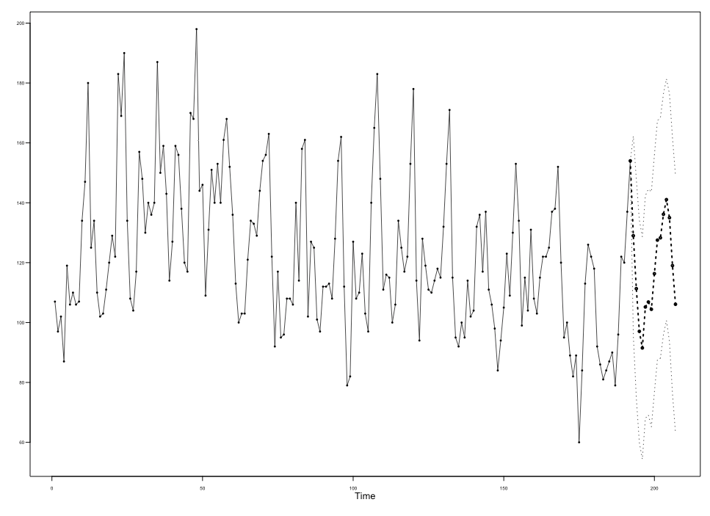
Model Selection and Forecast
Chose the one with lowest ASE
Forecasted out 15 months into the future
Other forecasts are in the R markdown associated with this presentation

Slide 25
Youtube Link
https://youtu.be/mdvwh750_Fo

